Slide 1


STATISTICAL STUDY WITH PLANNING ROUTES TO AVOID SEXUAL HARASSMENT IN MEDELLÍN.

Slide 2


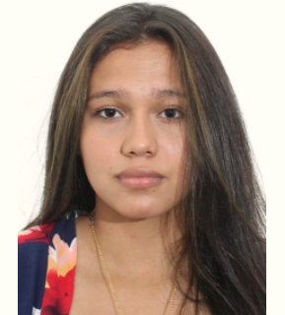
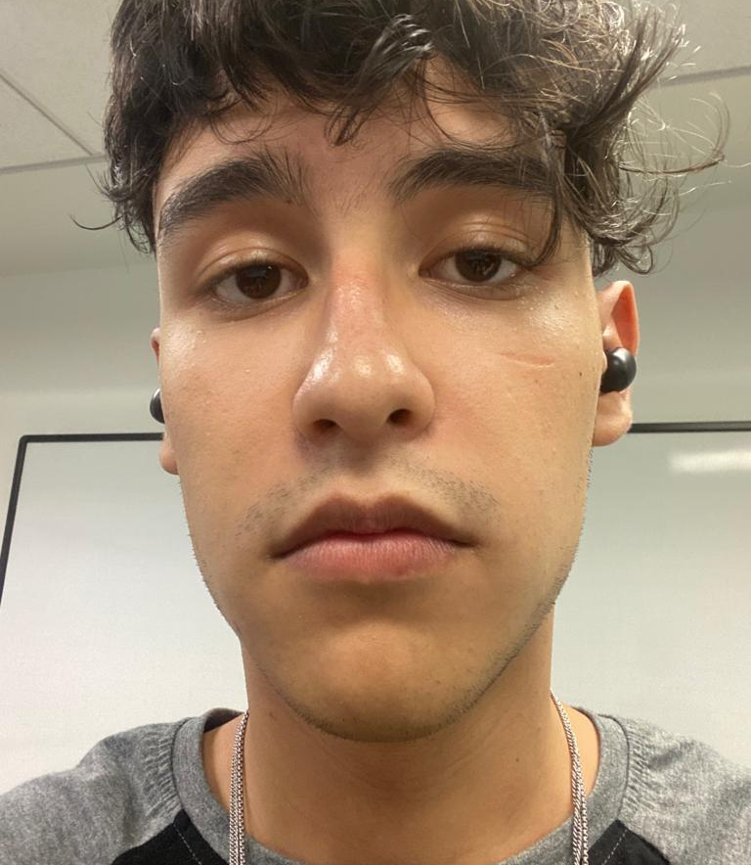


Team Presentation
Laura Danniela Zárate Guerrero.
Researcher and contributor.
Santiago Arias Higuita.
Designer and contributor.
Andrea Serna
Literature review
Mauricio
Toro
Data preparation
http://github.com/LauZar12/proyecto/

Slide 3
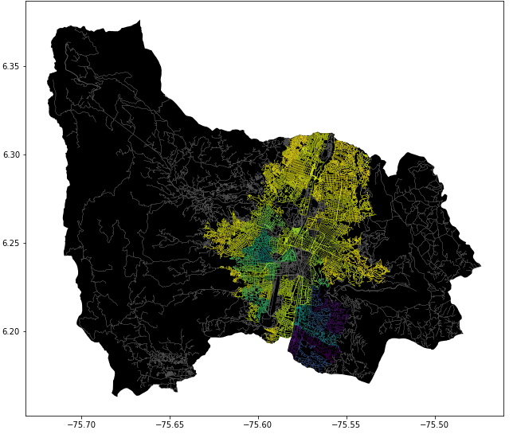
Problem Statement
Constrained Shortest Path Algorithm
Streets
of Medellín, Origin and Destination
Constrained
Shortest
Paths

Slide 4
First Algorithm
DIJKSTRA
r
Streets
of Medellín, Origin and Destination
Shortest path without exceeding a weighted-average risk of harassment r

Slide 5
Second Algorithm
DIJKSTRA
d
Streets
of Medellín, Origin and Destination
Path with the lowest weighted-average risk of harassment without exceeding a distance d

Slide 6
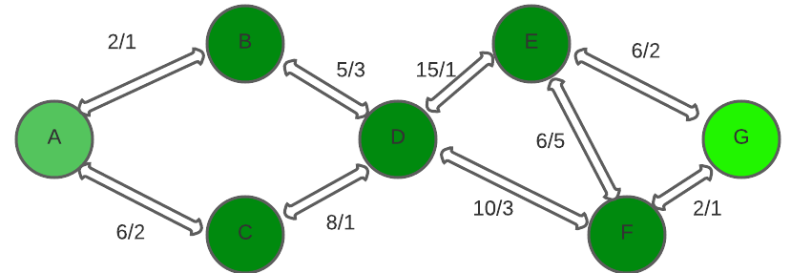

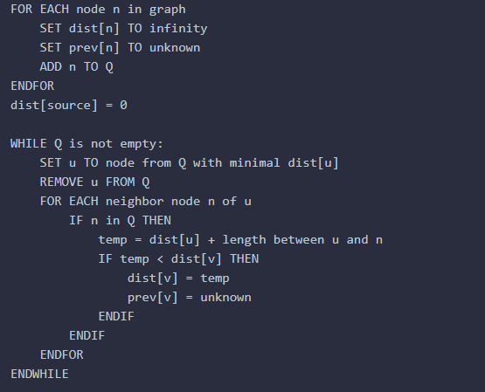
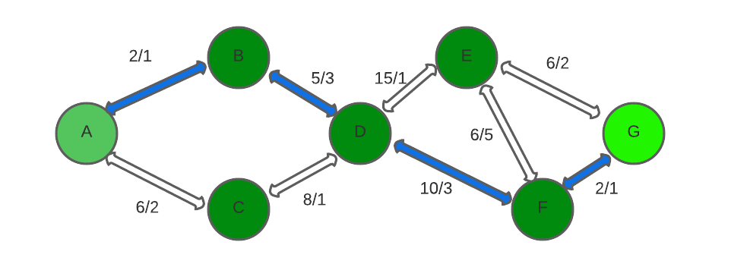
Algorithm Explanation
Fig 1
Fig 2
DIJKSTRA
Fig 3
We can observe a graph in fig1 containing two values ​​for each path from one node to another, that of the distance and that of the harassment. In fig2 we observe the operation of the Dijkstra algorithm, we can see how the algorithm search for each node the shortest path in its adjacent nodes and when it finds it, it adds them to the final path. This action is repeated until reaching the goal node. In fig 3 we can see the shortest path defined by the algorithm

Slide 7

Algorithm Complexity
 | Time Complexity | Memory Complexity
DIJKSTRA WITH MODIFIED WEIGHTS | O((|V|+|E|) log |V|) | O(V²)
On the table are the time and memory complexity of the algorithms where V is the number of nodes, E is the number of edges And the memory complexity it is the one showed there because we used it for every single street (we don´t use a binary monticule or a balanced binary tree).

Slide 8
Shortest Path Results
Origin | Destination | Shortest distance (meters)
Universidad EAFIT | Universidad de Medellín | 6142m
Universidad de Antioquia | Universidad Nacional | 815 m
Universidad Nacional | Universidad Luis Amigó | 1469 m
Shortest distance obtained.
In what follows, we present the results obtained for the shortest path due to new directions given in class harassment is not taken into account. We compare with Google maps and we have the same short distance.

Slide 9
Lowest Risk Results
Origin | Destination | Weighted-average risk of harassment
Universidad EAFIT | Universidad de Medellín | 0.642
Universidad de Antioquia | Universidad Nacional | 0.605
Universidad Nacional | Universidad Luis Amigó | 0.599
Lowest weighted-average risk of harassment obtained .
In what follows, we present the results obtained for the shortest path due to new directions given in class harassment is not taken into account. We compare with other partners and we have similar results but cause with have different csv we got interesting paths.

Slide 10






Algorithm Execution Times
Execution Times
13.5 seconds
11.5 seconds
12.49 seconds
The execution times for all the process with the algortihm are perfect for a real life situation , because complexity and the efiency of Dijkstra we can run the program faster and with no problems.

Slide 11

Future Work Directions
Databases
Project 1
Software Eng.
Project 2
Web app development
Add other variables
A Web Application
Multiplatform design
Data managing
Interface design
Cloud functionality
User management and market launch

Slide 12

THANK YOU!.
Supported by
The first two authors were supported by mejores bachilleres grant, financed by Medellín municipality and swizz scholarship financed by swizz education foundation. All the authors would like to thank the "Vicerrectoría de Descubrimiento y Creación", of Universidad EAFIT, for their support on this research.

